Slide 1
Bibliographic and inventory searching overview
Yoel Kortick
Senior Librarian

Slide 2

Agenda
Introduction
Simple search and advanced search
Filtering search results by facets
Searching for bibliographic records
Searching for inventory

Slide 3
Introduction

Slide 4
Introduction
In Alma it is possible to search for
  Bibliographic data
  Inventory Data
  Authority data
  Administrative Data

Slide 5
Introduction
Administrative data includes:
  Patron requests
  Courses
  Users
  Acquisitions information, including PO lines, funds, invoices, vendors, and licenses
  Reading lists
  Reading list citations
  Borrowing Requests
  Lending Requests

Slide 6
Introduction
The list of entities which can be searched depends on the user roles.
As a result, not every user sees the same options for searching.
See User Roles for Search Types

Slide 7
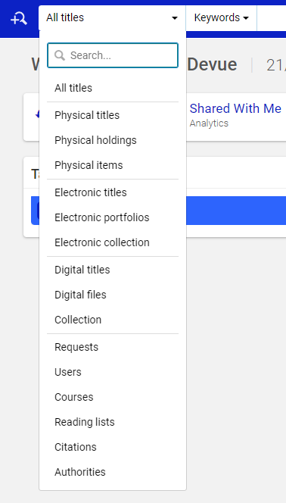
Introduction
This is what a user without all roles may see when searching
This user for example can not search for acquisitions data due to his or her roles. The next user (on the next slide) does have the option to search for acquisitions data due to his or her roles.

Slide 8
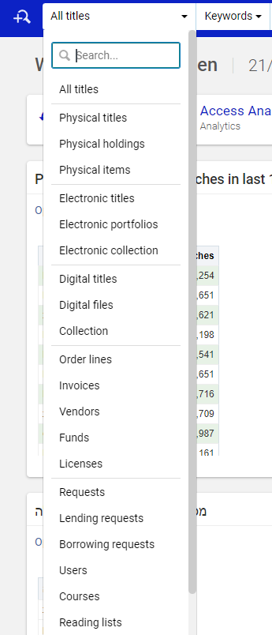
Introduction
This is what a user with all roles may see when searching.
This user for example can search for acquisitions data due to his or her roles. The previous user does not have these options due to his or her roles.

Slide 9
Introduction
This presentation will not focus on administrative or authority data.
We will focus on:
  Bibliographic Data
  Inventory Data

Slide 10
Simple search and advanced search

Slide 11
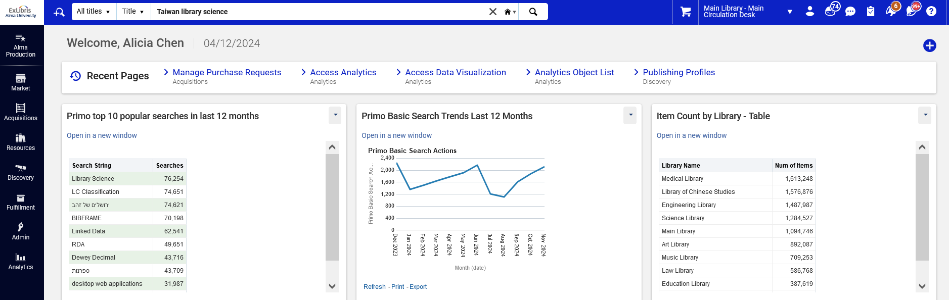
Simple search and advanced search
Simple search searches by one field at a time and is accessed from the persistent search box on the top of Alma
Persistent search box

Slide 12
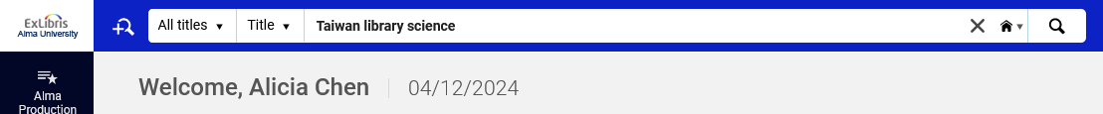
Simple search and advanced search
Advanced search allows for searching multiple fields at a time and using Boolean operators.
It is accessed by clicking the advanced search icon next to the persistent search box.
Advanced search icon

Slide 13
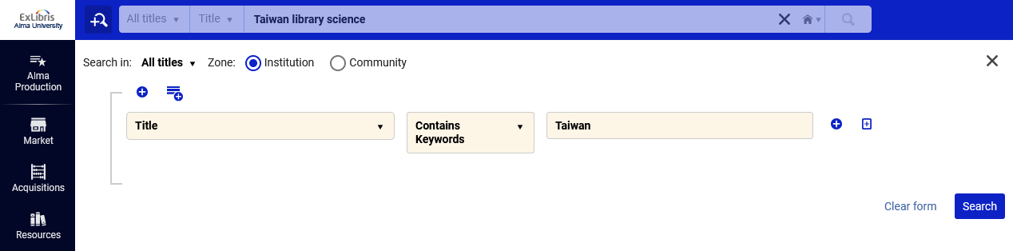
Simple search and advanced search
Within the advanced search a user can click the “+” to add additional fields

Slide 14
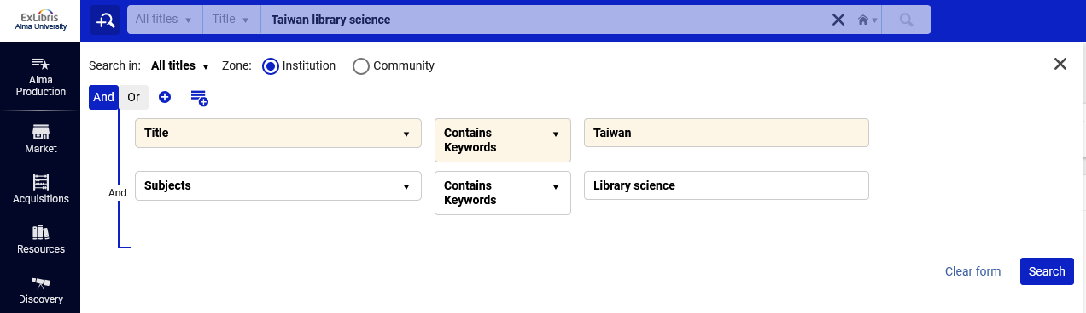
Simple search and advanced search
This will search for all records with keywords “Taiwan” in the title and keywords “Library science” in the subjects
Currently the Boolean operator is “and”. We can click “or” to change it to “or”.

Slide 15
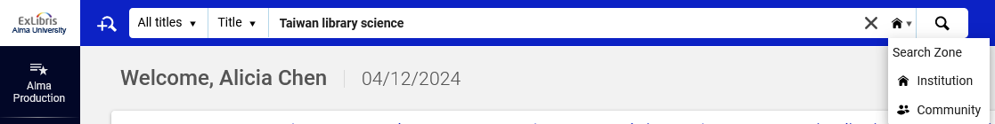
Simple search and advanced search
In both the simple search and the advanced search, it is possible to choose whether to search the institution zone or the community zone.
Simple search option to choose Institution Zone or Community Zone

Slide 16
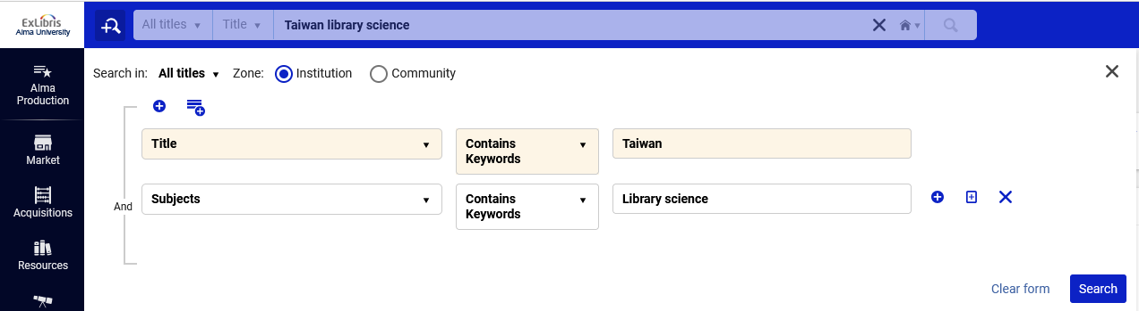
Simple search and advanced search
In both the simple search and the advanced search, it is possible to choose whether to search the institution zone or the community zone.
Advanced search option to choose Institution Zone or Community Zone

Slide 17
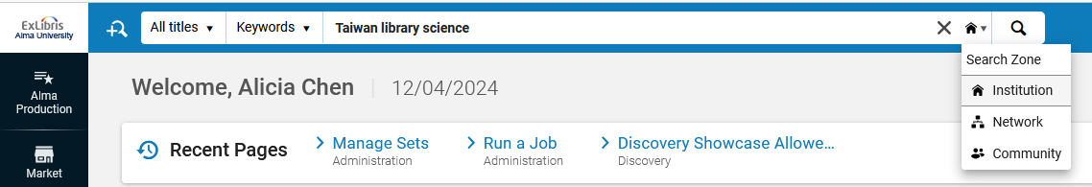
Simple search and advanced search
In both the simple search and the advanced search, for an institution which is a member institution of a network zone consortium, it is possible to choose whether to search the institution zone or the network zone or the community zone.
Simple search option to choose Institution Zone or Network Zone or Community Zone

Slide 18
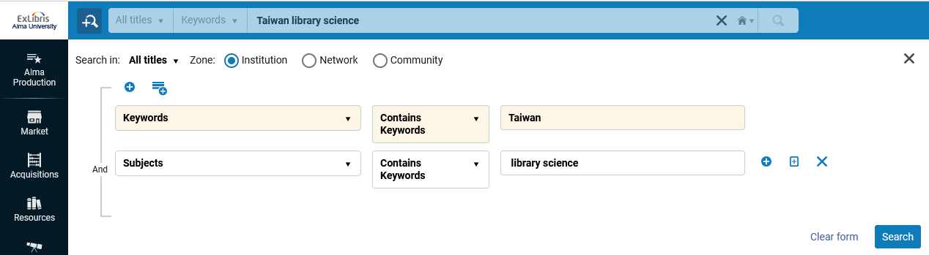
Simple search and advanced search
In both the simple search and the advanced search, for an institution which is a member institution of a network zone consortium, it is possible to choose whether to search the institution zone or the network zone or the community zone.
Simple search option to choose Institution Zone or Network Zone or Community Zone

Slide 19
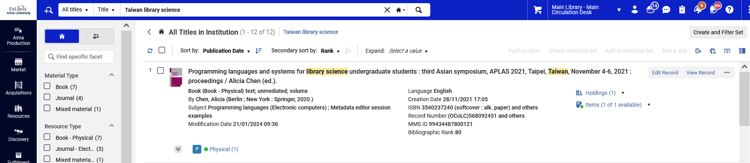
Simple search and advanced search
From the simple search results, we can see the number of results and the text we searched for

Slide 20
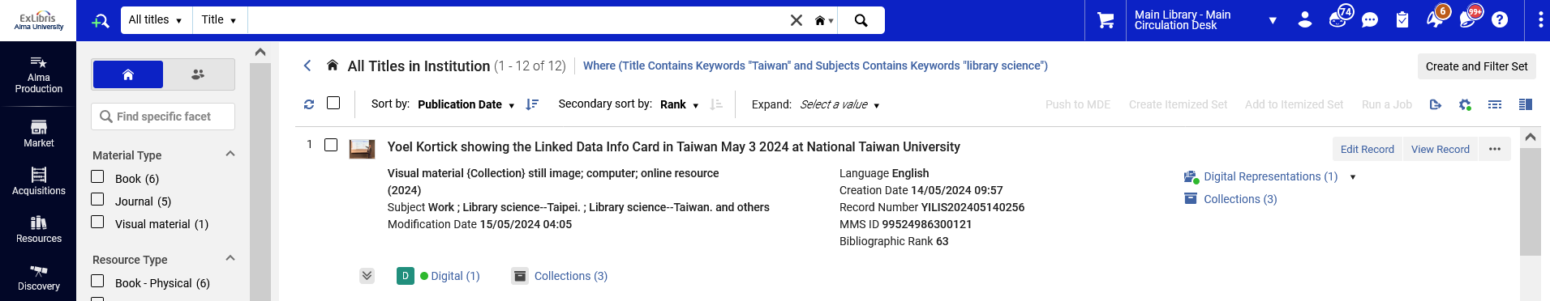
Simple search and advanced search
From the advanced search results, we can see the number of results and the query we searched for

Slide 21
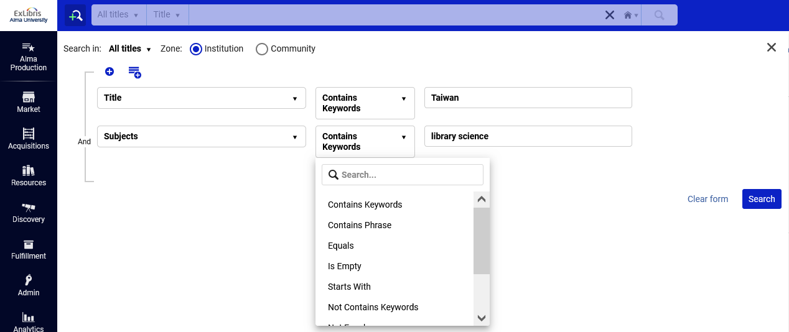
Simple search and advanced search
The advanced search allows for different operators within the search field

Slide 22
Simple search and advanced search
The list of fields available to search for in the simple search and advanced search differ.
Typically, the simple search includes frequently searched fields, while the advanced search contains both frequently searched fields as well as less frequently searched fields.
Each institution can change the default setup to include the specific fields it wants to appear in each type of search (Configuration > Resources > Search Configuration > Search Indexes)

Slide 23
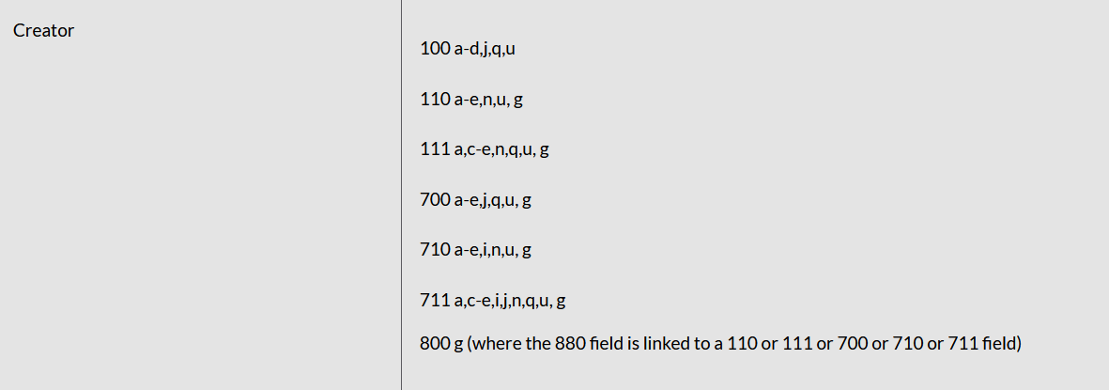
Simple search and advanced search
The contents of each of the searchable fields (what MARC fields and subfields are indexed to the searchable field) are listed in detail at Available Search Indexes
For example, these are the MARC21 fields and subfields indexed in the “Creator” search field for an “All Titles” search

Slide 24
Filtering search results by facets

Slide 25
Filtering search results by facets
It is possible to filter search results using the facets in the left pane of the search results.
The available facets depend on the type of search and the items in the search results.
See “Search Result Facets” at Filtering Search Results

Slide 26
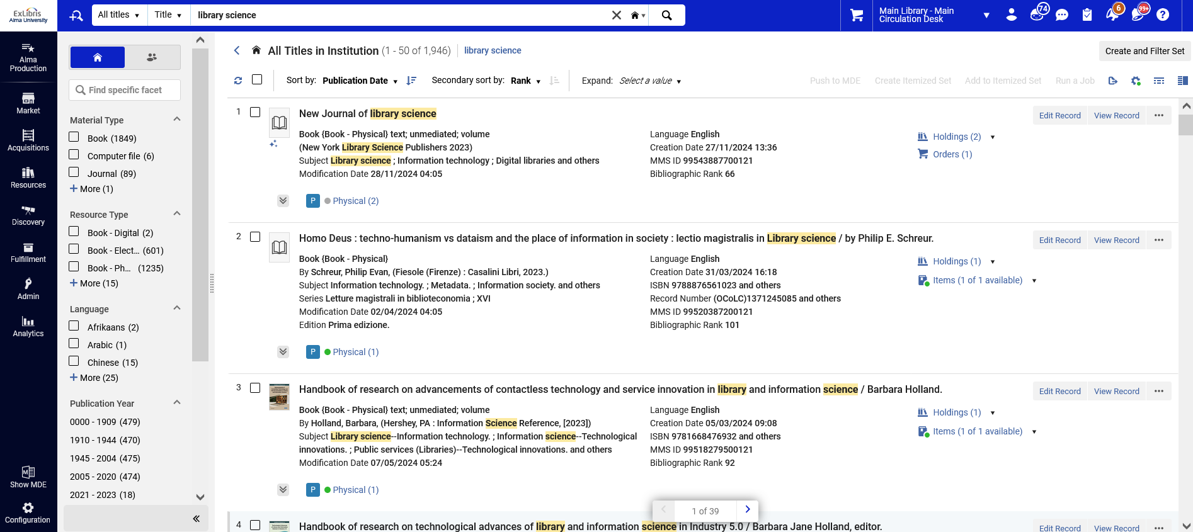
Filtering search results by facets
Facets for an “All Titles” search
The facet pane can be collapsed to allow more record display on the screen

Slide 27
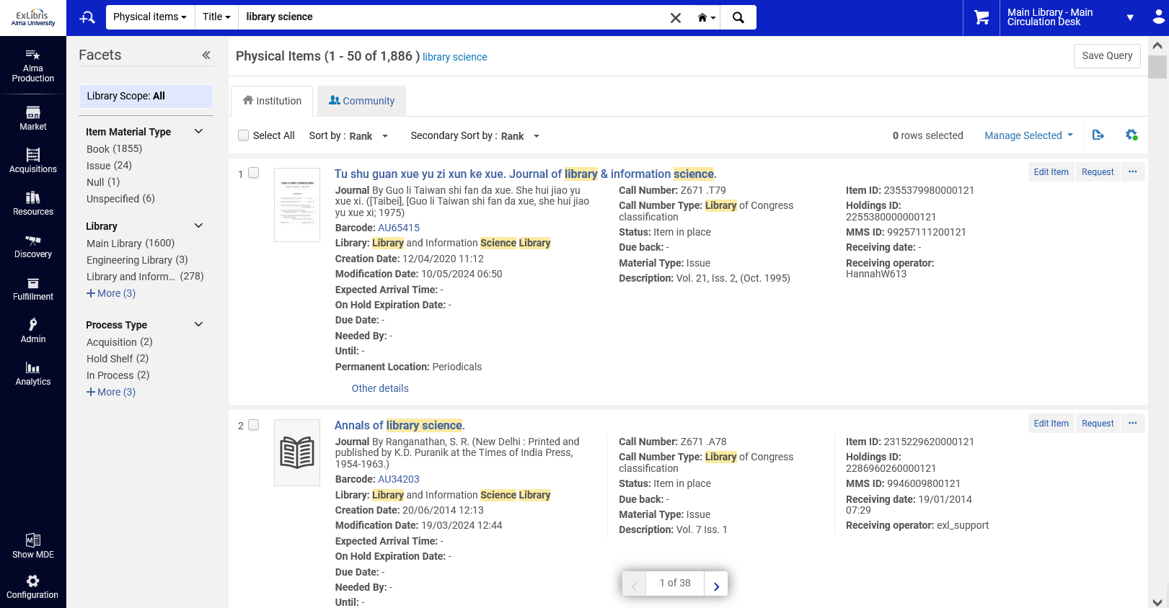
Filtering search results by facets
Facets for a “Physical Items” search

Slide 28
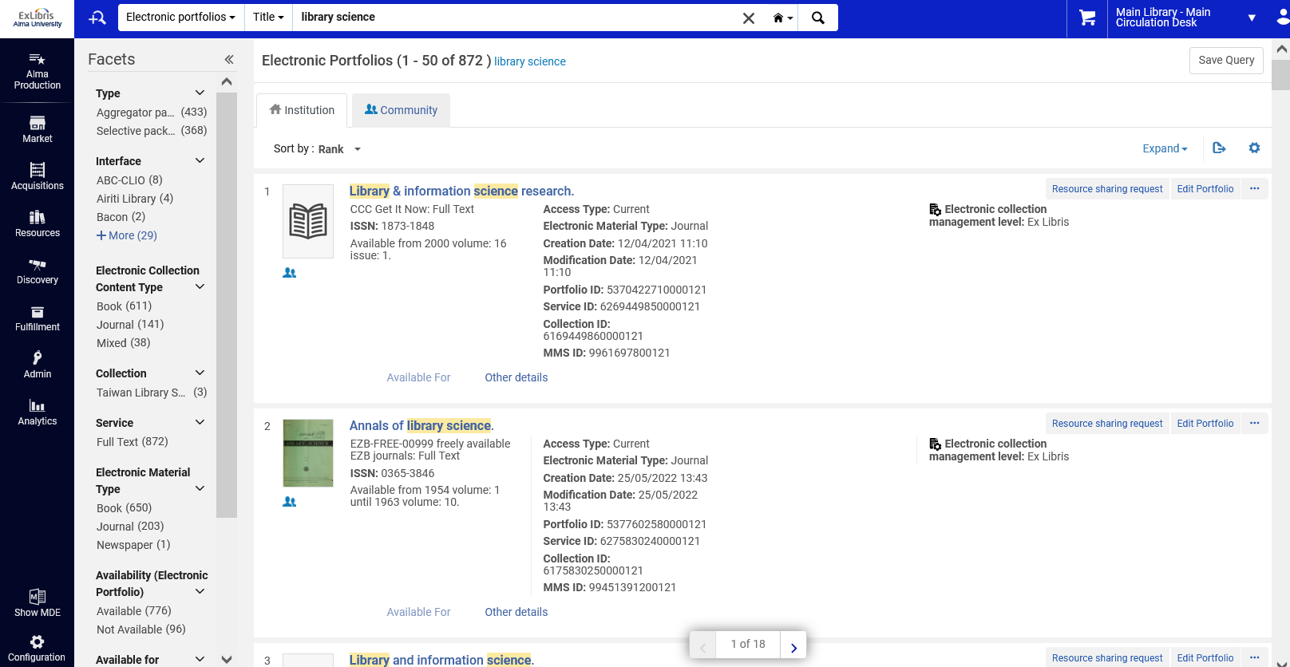
Filtering search results by facets
Facets for an “Electronic portfolios” search

Slide 29
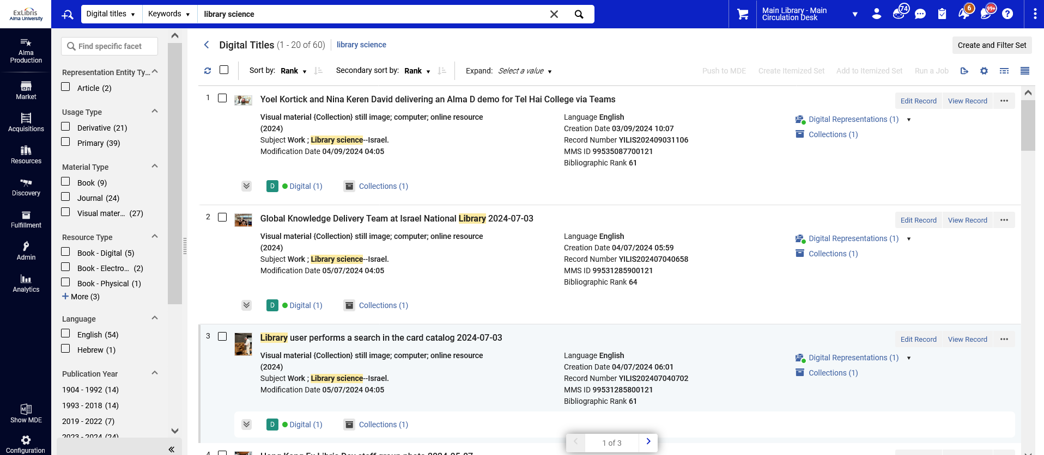
Filtering search results by facets
Facets for a “Digital titles” search

Slide 30
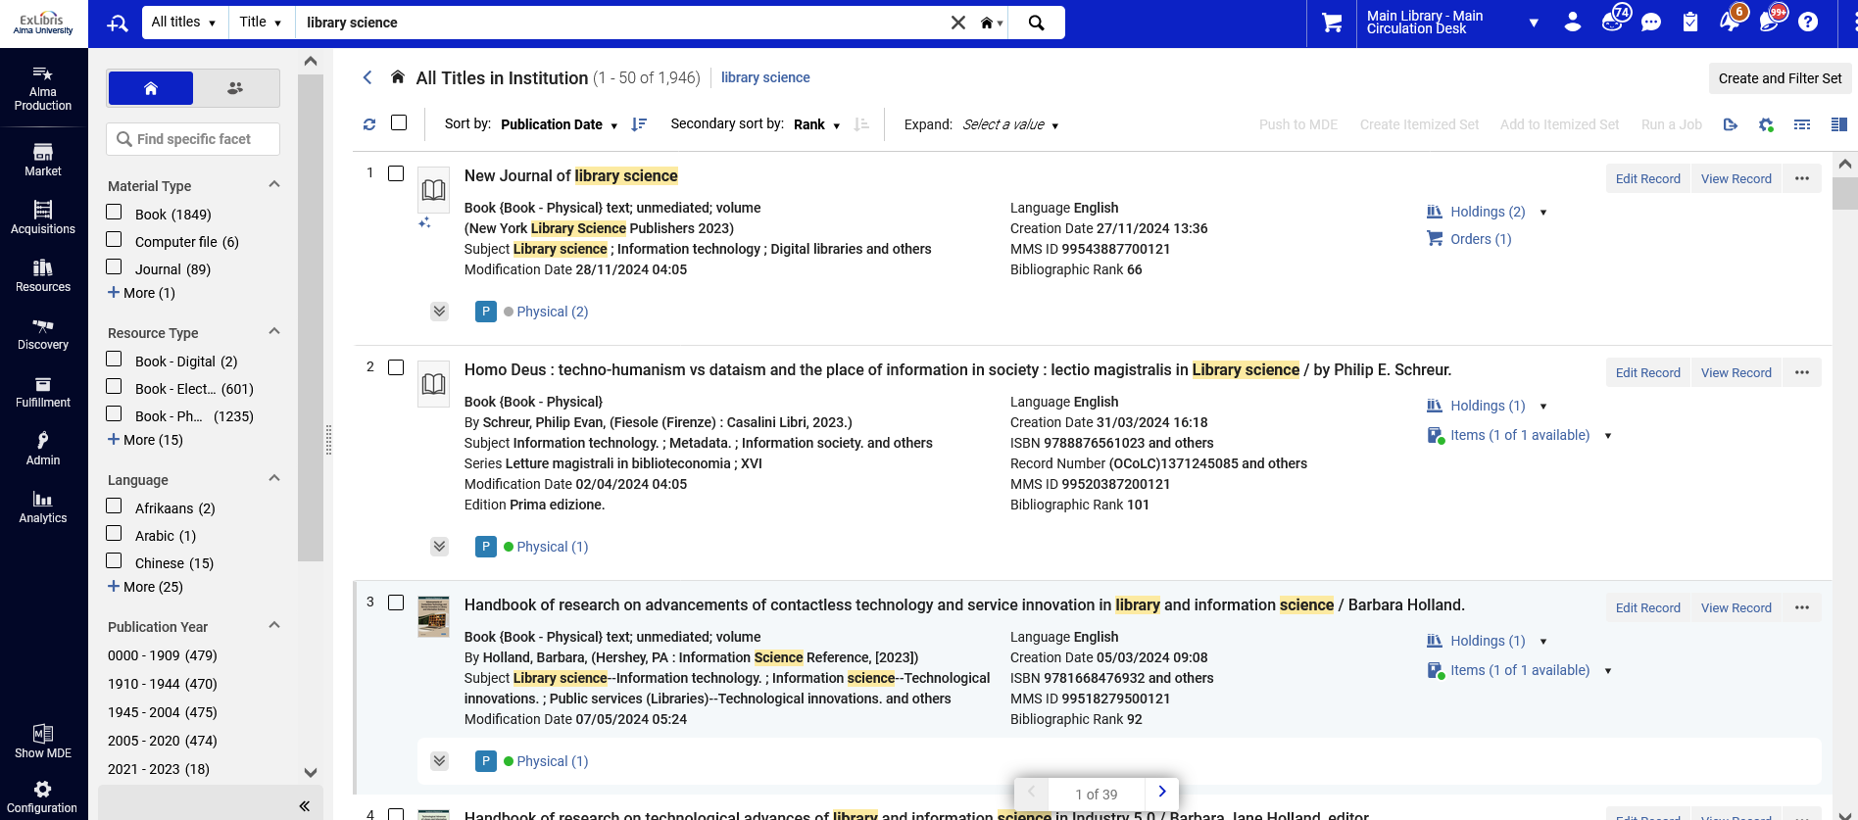
Filtering search results by facets
To perform a filtering of the search results via the facets:
Click one or more of the facets from the facet pane on the left.
We will facet here by first by Material type = Book

Slide 31
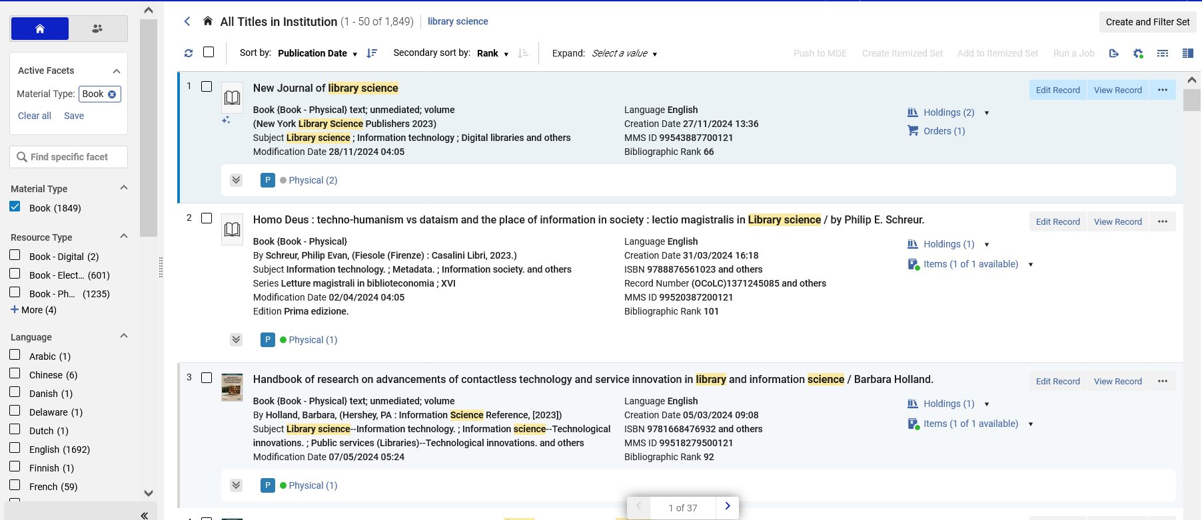
Filtering search results by facets
Now we have results for a facet by Material type = Book
The number of results next to each facet in the facet pane has been updated according to the “Material type = book” facet that we already did.
Now we will facet by Language = English

Slide 32
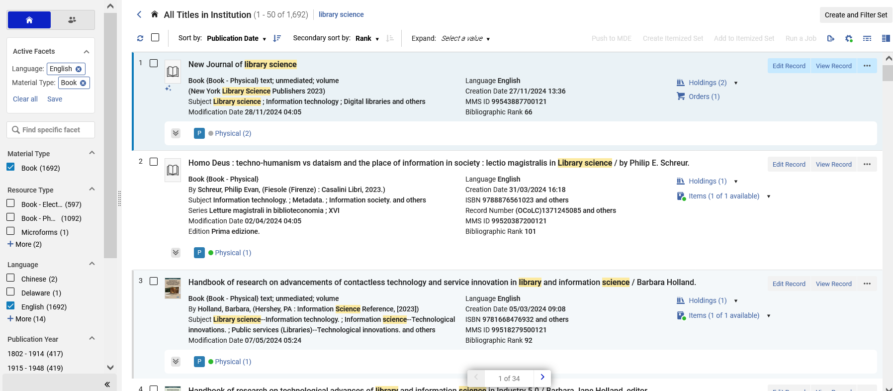
Filtering search results by facets
Now we have filtered our initial search by Material type = Book and Language = English

Slide 33
Searching for bibliographic records

Slide 34
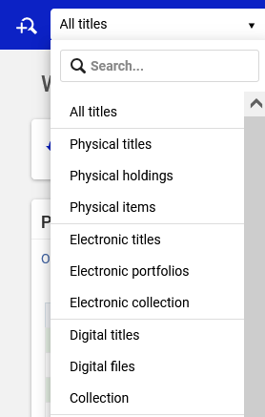
Searching for bibliographic records
Bibliographic records may be searched via the various “Titles” searches.
These include:
  All Titles
  Physical Titles
  Electronic Titles
  Digital Titles

Slide 35
Searching for bibliographic records
All Titles = Searches for bibliographic records which have physical inventory, or electronic inventory, or digital inventory, or no inventory
Physical Titles = Searches for bibliographic records which have at least one holdings record. The presence of a holdings record, even without physical items attached, is enough for the record appear in the “Physical Titles” search results.

Slide 36
Searching for bibliographic records
Electronic Titles = Searches for bibliographic records that have electronic inventory. This may be standalone portfolios or portfolios which are part of electronic collections.
Digital Titles = Searches for bibliographic records which have a digital representation. The presence of a digital representation, even without digital files attached, is enough for the record to appear in the “Digital Titles” search results.

Slide 37
Searching for bibliographic records
On the next four slides we will search for “title” “Gloria Steinem”.
We will do this for all four “titles” searches:
  All Titles
  Physical Titles
  Electronic Titles
  Digital Titles
Each time we will get different results because of the inventory associated with the bibliographic record.

Slide 38
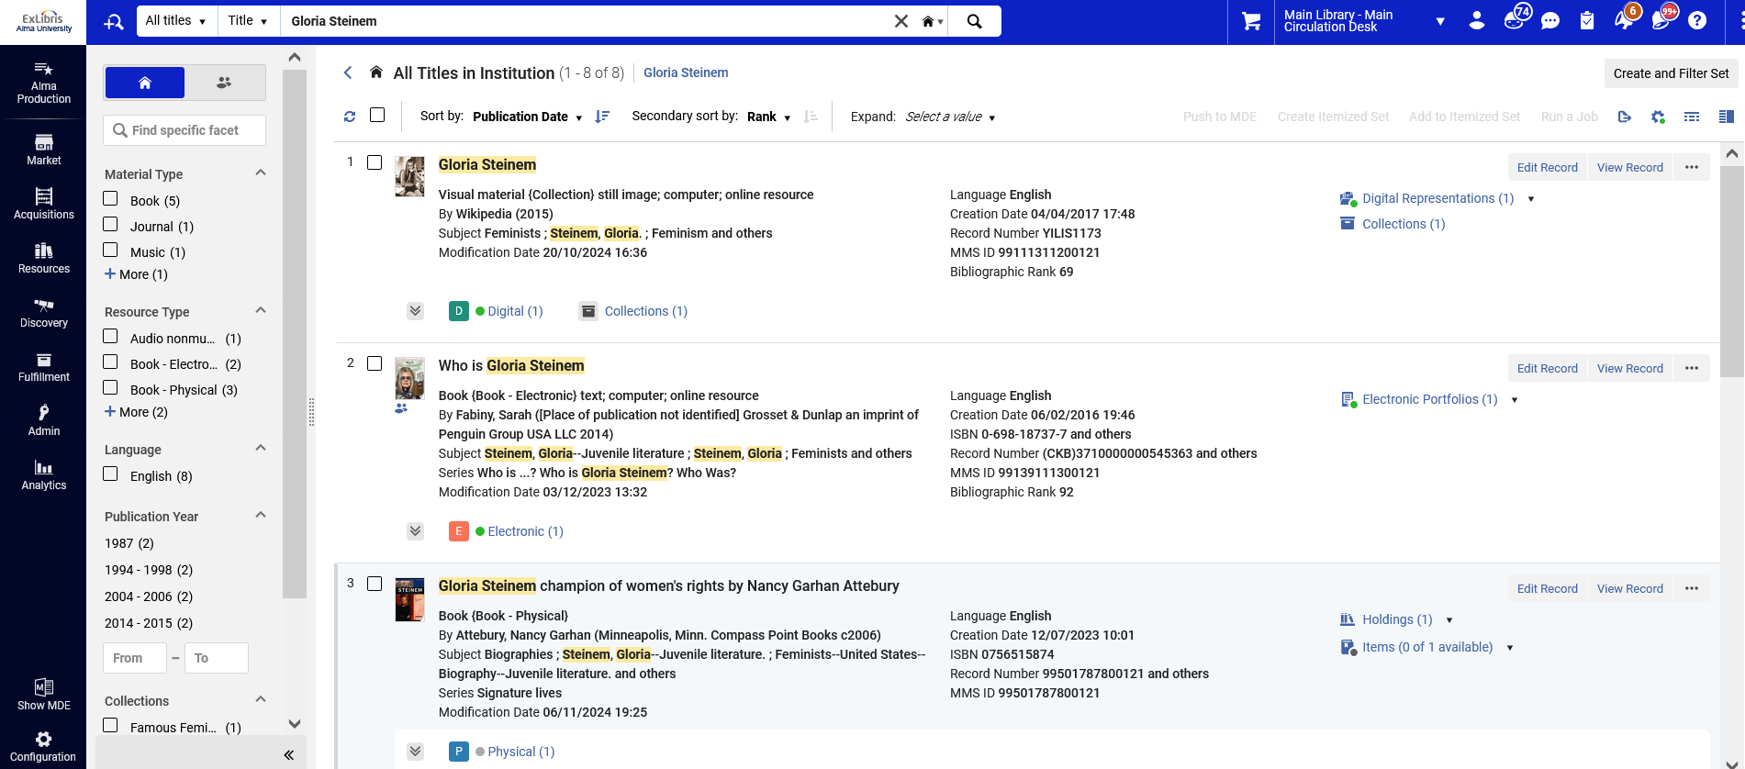
Searching for bibliographic records
An “All Titles” search retrieves bibliographic records with any type of inventory or no inventory.

Slide 39
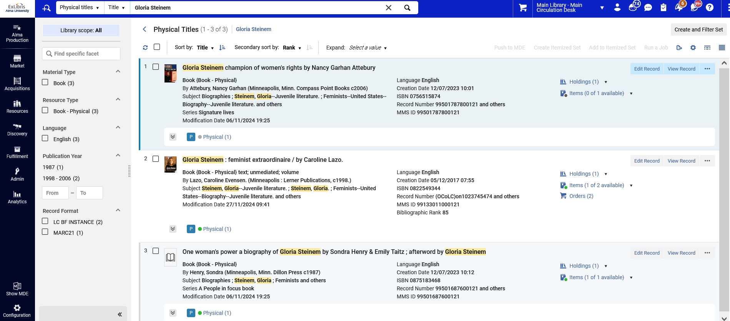
Searching for bibliographic records
A “Physical Titles” search retrieves bibliographic records with at least one holdings record.

Slide 40
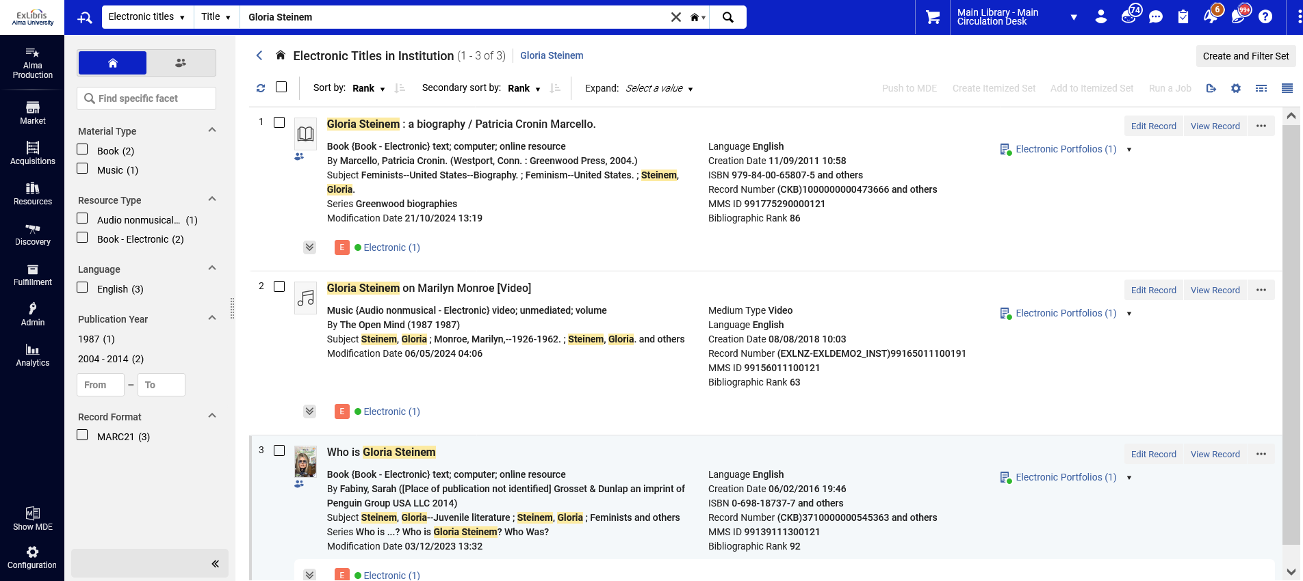
Searching for bibliographic records
An “Electronic Titles” search retrieves bibliographic records with at least one portfolio (either a standalone or part of an electronic collection).

Slide 41
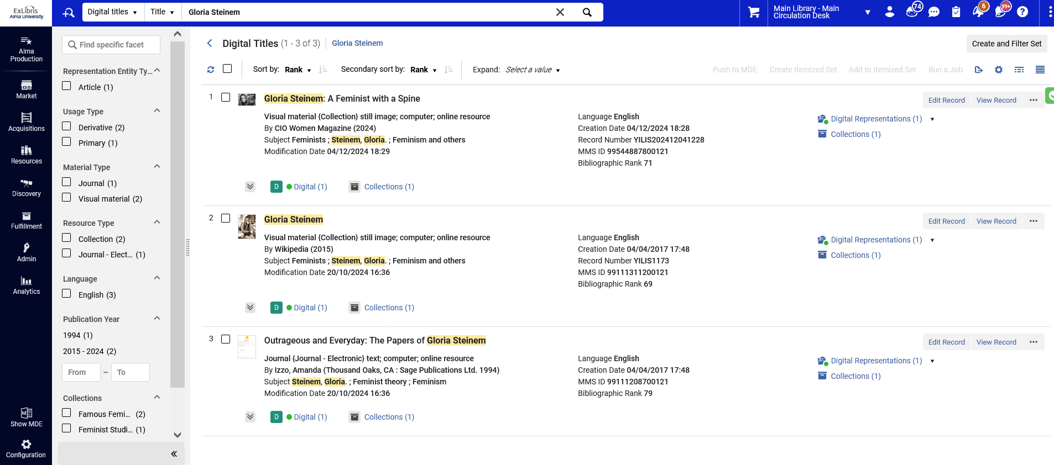
Searching for bibliographic records
A “Digital Titles” search retrieves bibliographic records with at least one Digital Representation.

Slide 42
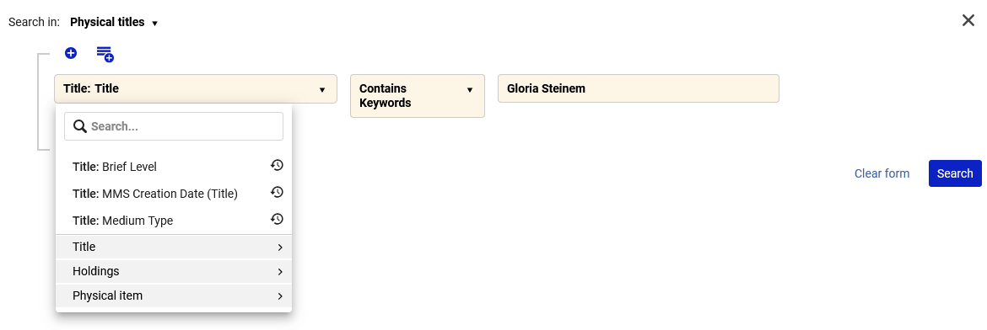
Searching for bibliographic records
Note that when doing an advanced search via “Physical Titles” and “Electronic Titles” and “Digital Titles” it is possible to search by both bibliographic as well as inventory fields.
For example, in the “Physical Titles” search the user can also search for holdings and physical items fields.

Slide 43
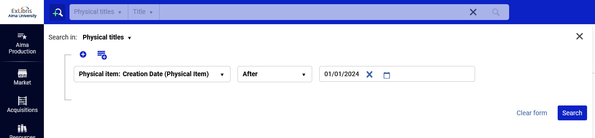
Searching for bibliographic records
For example, we can search for all “Physical Titles” which have a physical item created after Jan. 1, 2024

Slide 44
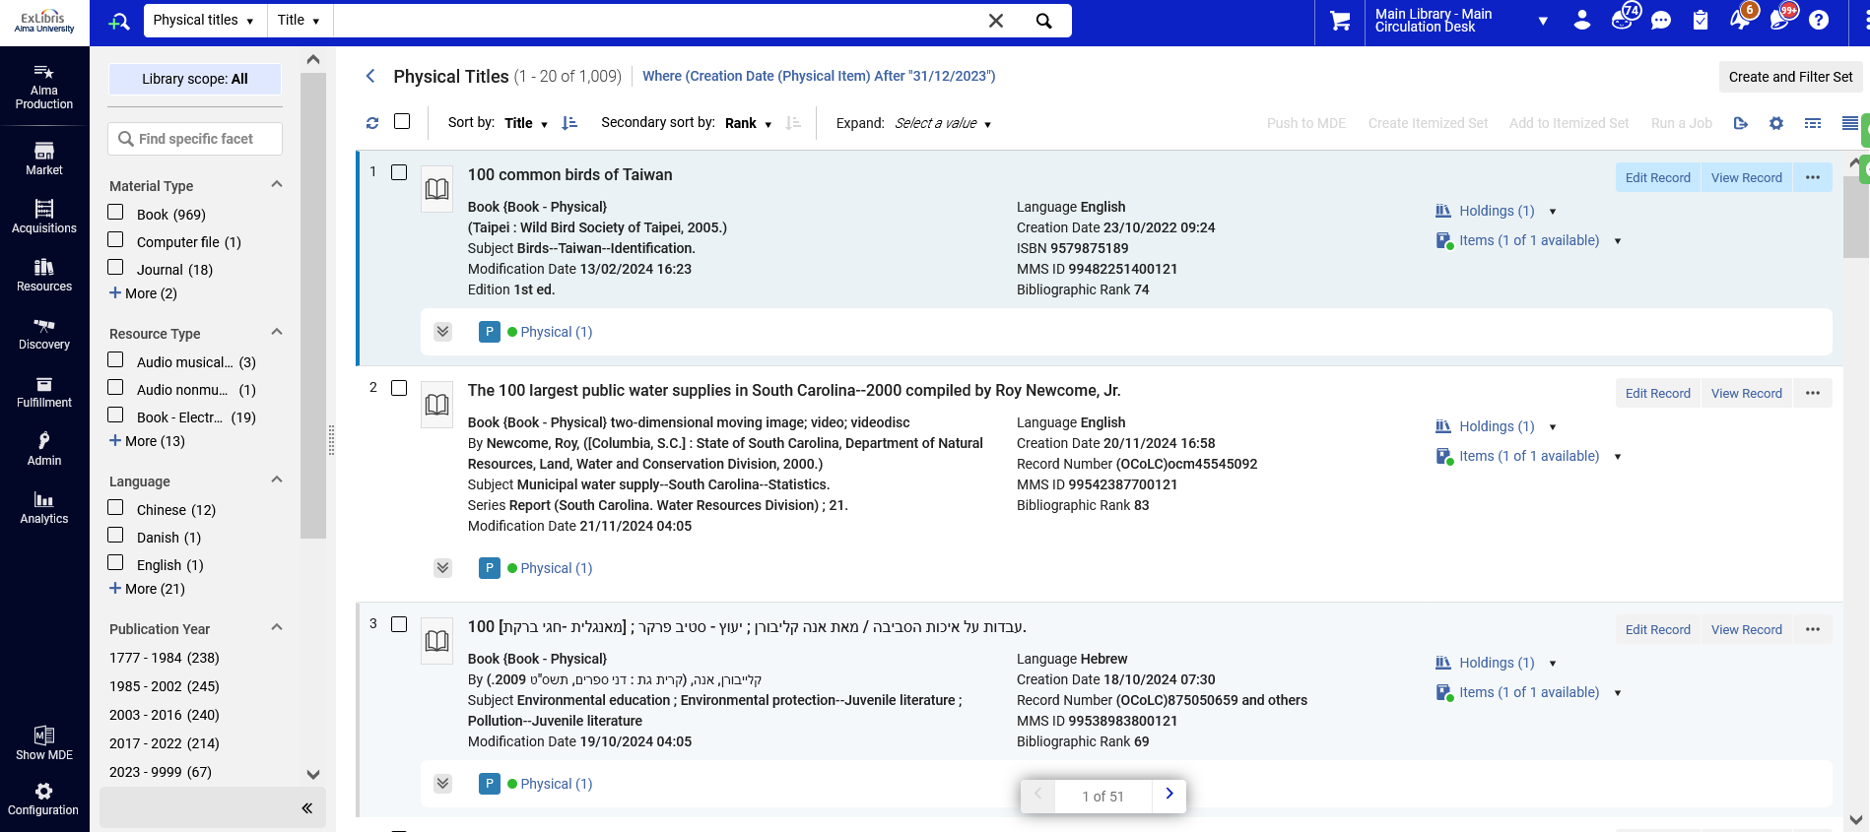
Searching for bibliographic records

Slide 45
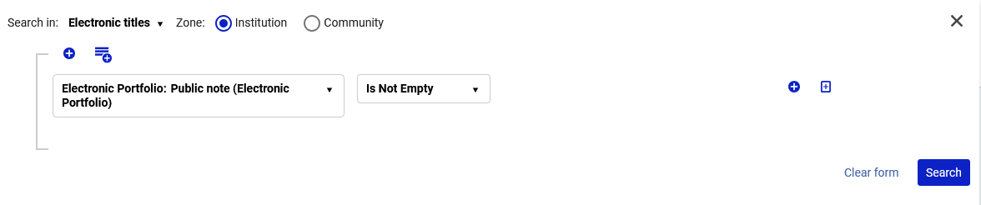
Searching for bibliographic records
Similarly, when searching via “Electronic Titles” the user can also search for electronic collection and electronic portfolio fields.
For example, we can search for all “Electronic Titles” which have an electronic portfolio that has a public note.

Slide 46
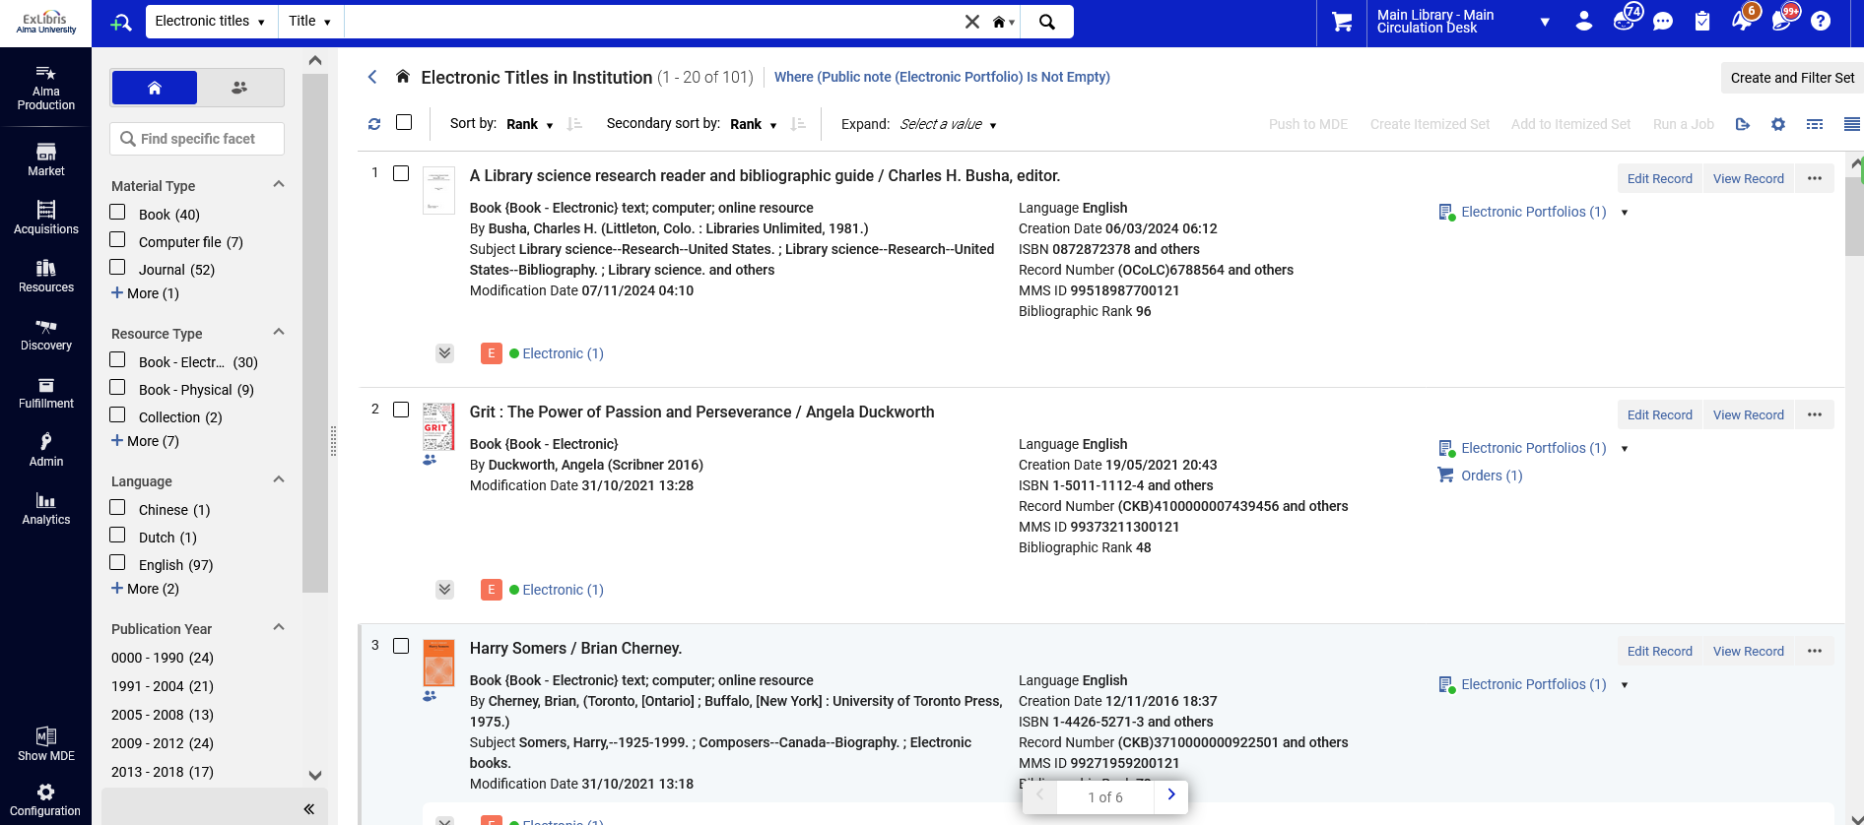
Searching for bibliographic records

Slide 47
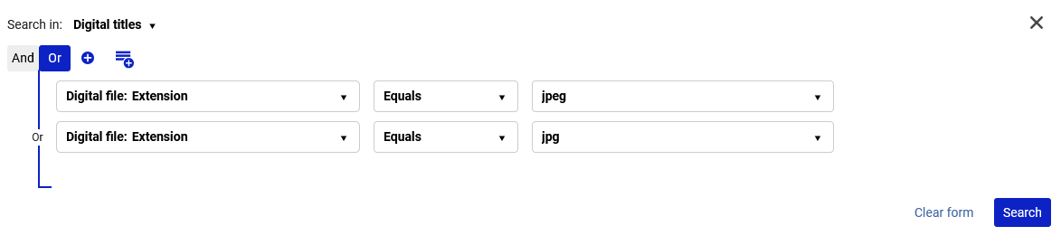
Searching for bibliographic records
Similarly, when searching via “Digital Titles” the user can also search for digital representation and digital file fields.
For example, we can search for all “Digital Titles” which have a digital representation that has files of type jpeg or jpg.

Slide 48

Searching for bibliographic records

Slide 49
Searching for inventory

Slide 50
Searching for inventory
Inventory can be searched in Alma via the following search types:

Slide 51
Searching for inventory
Inventory can be searched in Alma via the following search types:
Physical
  Physical Holdings – Searches for and displays the holdings record
  Physical Items – Searches for and displays the physical items
Electronic
  Electronic Portfolios – Searches for and displays the physical items
  Electronic Collections – Searches for and displays the Electronic Collections
Digital
  Digital Files – Searches for and displays the Digital Files
  Collection – Searches for and displays the title level collection

Slide 52
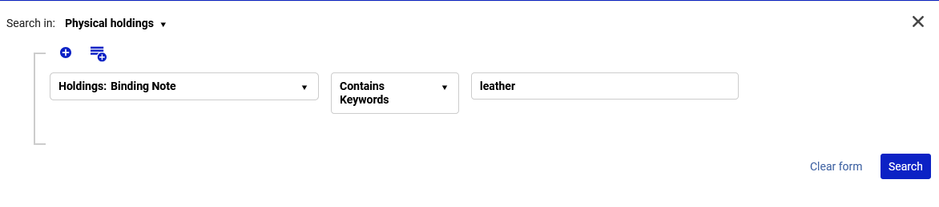
Searching for inventory
For example, here we search for physical holdings that contain a binding note containing keyword “leather”

Slide 53
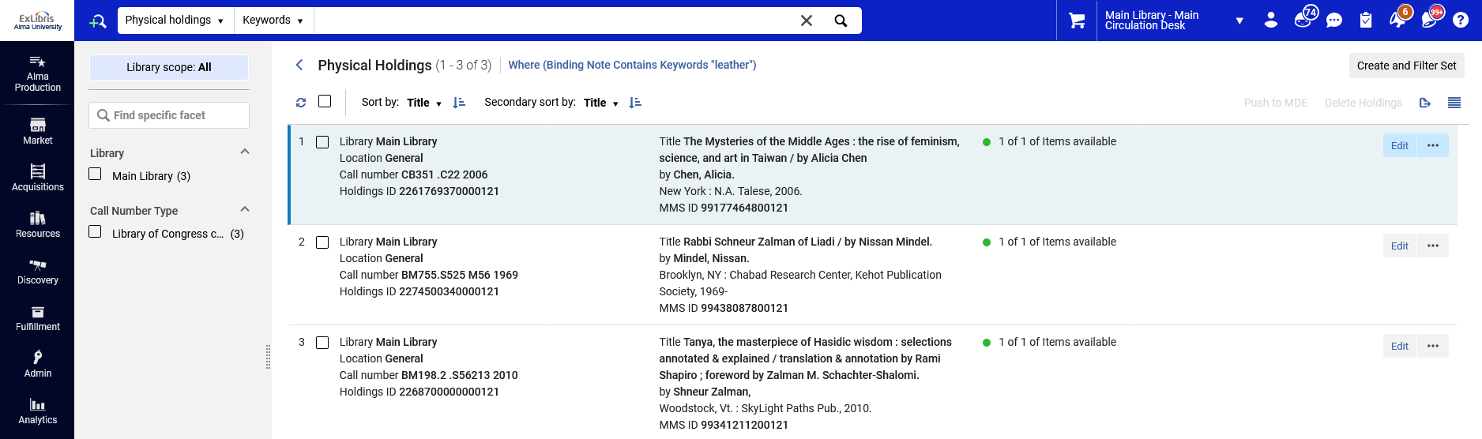
Searching for inventory

Slide 54
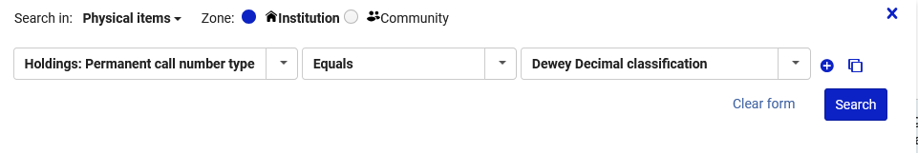
Searching for inventory
For example, here we search for physical items that contain a permanent call number type “Dewey Decimal Classification”

Slide 55
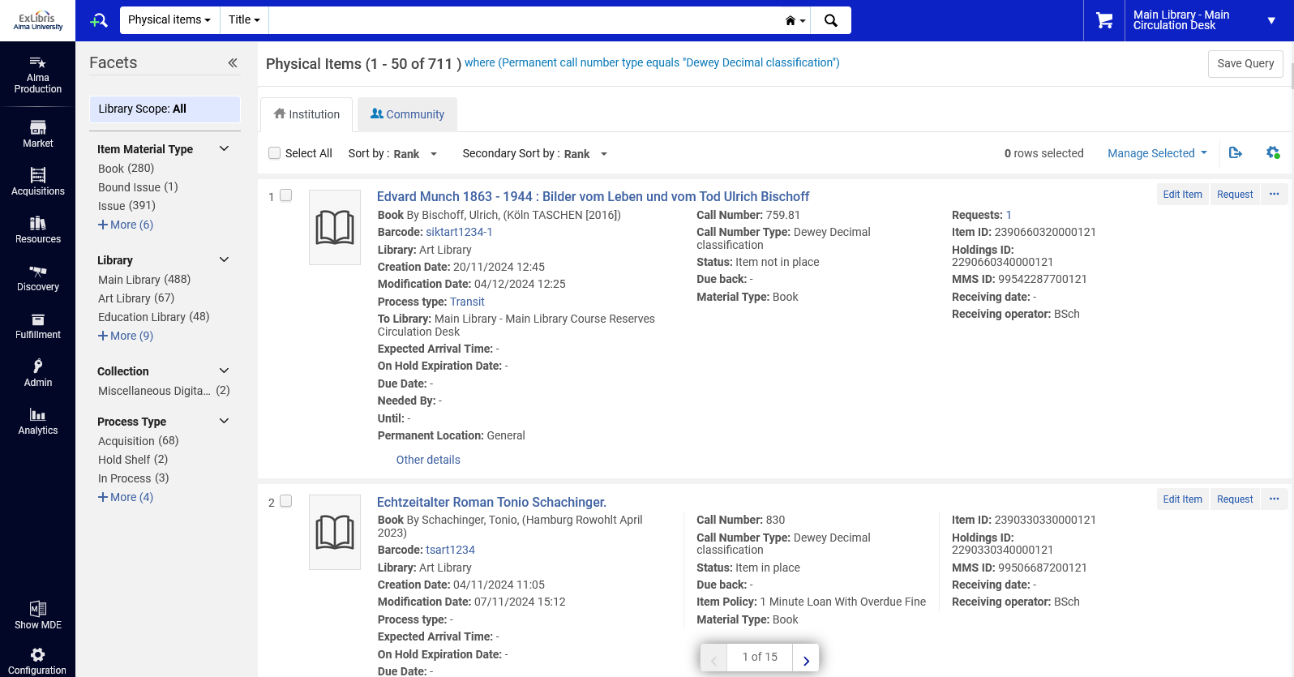
Searching for inventory

Slide 56
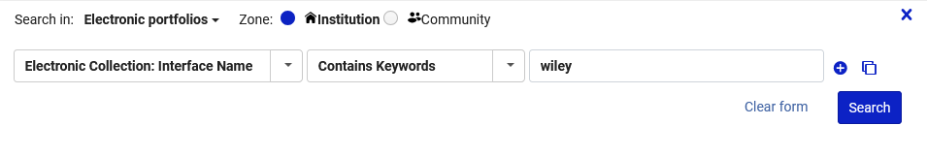
Searching for inventory
For example, here we search for electronic portfolios that contain an interface name containing keyword “Wiley”

Slide 57
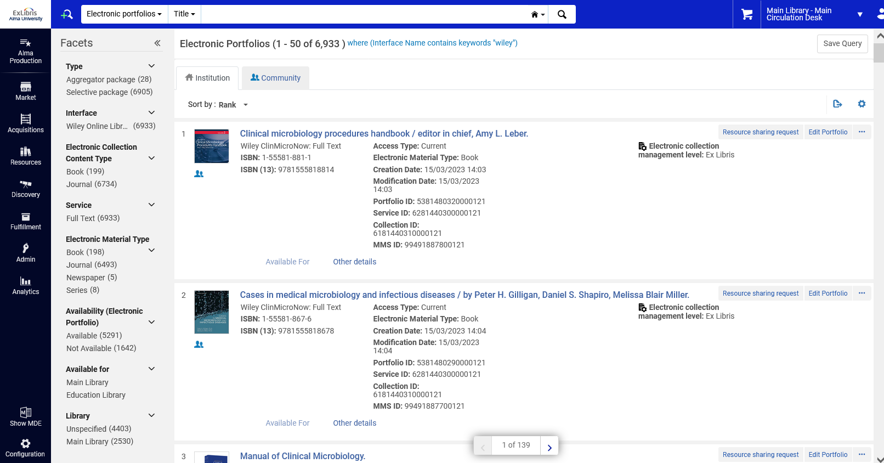
Searching for inventory

Slide 58

Searching for inventory
For example, here we search for digital files that contain a label containing keyword “Steinem”

Slide 59
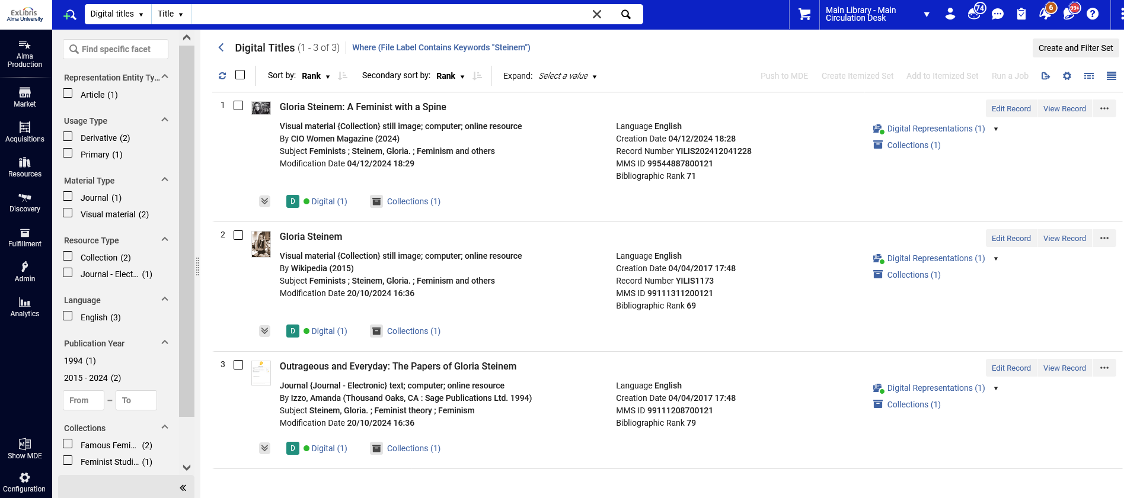
Searching for inventory

